Slide 1
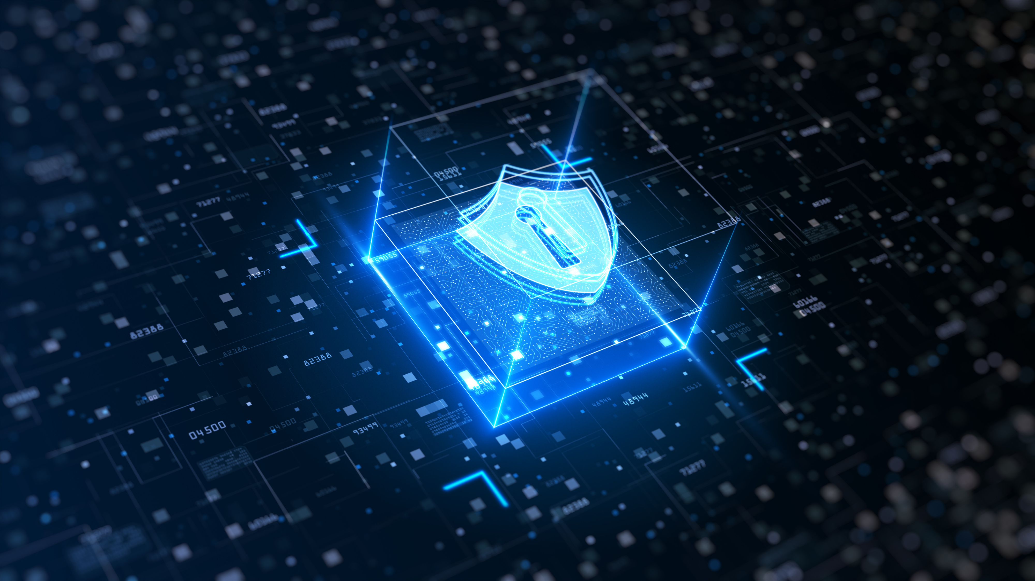



c
STAY SAFE
ONLINE
CYBER SECURITY AWARENESS WORKSHOP
Presented By
Date(s)
OFFICE OF INFOMATION TECHNOLOGY
OCTOBER 22, 2025, WEDNESDAY &
OCTOBER 23, 2025, THURSDAY
DEPARTMENT OF FINANCE

Slide 2

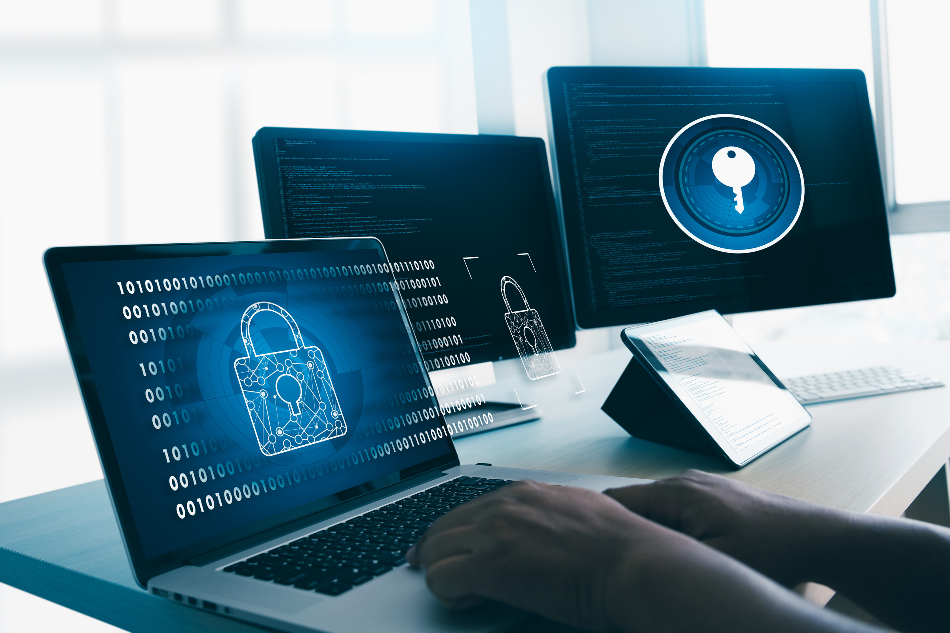
AGENDA
8:30AM -
9:00AM
REGISTRATION/ WELCOMING REMARKS
JOAQUINA ‘KINA” BABAUTA
OFFICE OF INFORMATION TECHNOLOGY (OIT)
9:00AM -
9:30AM
SESSION 1:
EMPOWERING THE HUMAN FIREWALL:
STAYING SAFE ONLINE FOR GOVT. EMPLOYEES
JONATHAN LIWAG OF QUIBIT LEARNING SOLUTIONS
(Presenter)
9:30AM -
10:00AM
SESSION 2:
CYBERSECURITY
JOAQUINA ‘KINA” BABAUTA
OFFICE OF INFORMATION TECHNOLOGY (OIT)
10;00AM -
10:10AM
BREAK
10:10AM -
10:40AM
SESSION 3:
PHYSICAL SECURITY
JOSEPH SHAUN SANTOS
OFFICE OF INFORMATION TECHNOLOGY (OIT)
10:40AM -
11:10AM
SESSION 4:
JITBIT HELPDESK PORTAL
JOSTAN INOKE
OFFICE OF INFORMATION TECHNOLOGY (OIT)
11:10AM -
11:40AM
BREAK
11:40AM -
11:50AM
SESSION 5:
INTERACTIVE ACTIVITIES
FRANK CELIS
OFFICE OF INFORMATION TECHNOLOGY (OIT)
11:50AM -
12:15AM
Q&A PANEL
12:15PM -
12:30PM
CLOSING REMARKS
JOAQUINA ‘KINA” BABAUTA
OFFICE OF INFORMATION TECHNOLOGY (OIT)

Slide 3

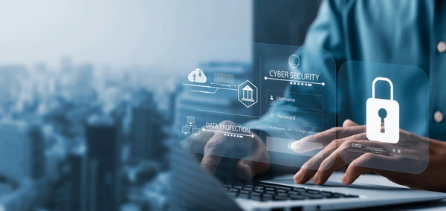
WELCOMING
REMARKS
JOAQUINA
“KINA”
BABAUTA

Slide 4
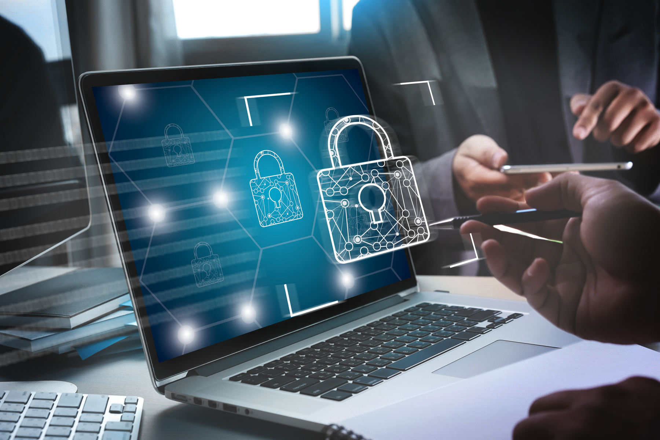
SESSION 1:
EMPOWERING THE HUMAN FIREWALL:
STAYING SAFE ONLINE FOR GOVERNMENT EMPLOYEES
PRESENTER:
JONATHAN
LIWAG
QUIBIT LEARNING SOLUTIONS

Slide 5
This presentation does not represent the views of the District Court for the Northern Mariana Islands. The information provided does not constitute policy implementation recommendations or technical advice; instead, all information, content, and materials presented are for general informational purposes only.
Disclaimer

Slide 6
Agenda
Introduction
What is the Human Firewall?
Evolving Threat Landscape
Recognizing Social Engineering Attacks
Social Engineering Principles
Building a Security-Conscious Culture
Spot and Report Incidents

Slide 8

What is the Human Firewall?
Where humans are the strongest defense, not the weakest link.
Notes:
Cyber incidents have a blast radius.

Slide 9
The Evolving Threat Landscape
AI-Driven Threats: Deepfakes, AI-personalized phishing, voice spoofing
Manipulative Tactics (Social Engineering): Exploiting urgency, authority, and trust

Slide 10
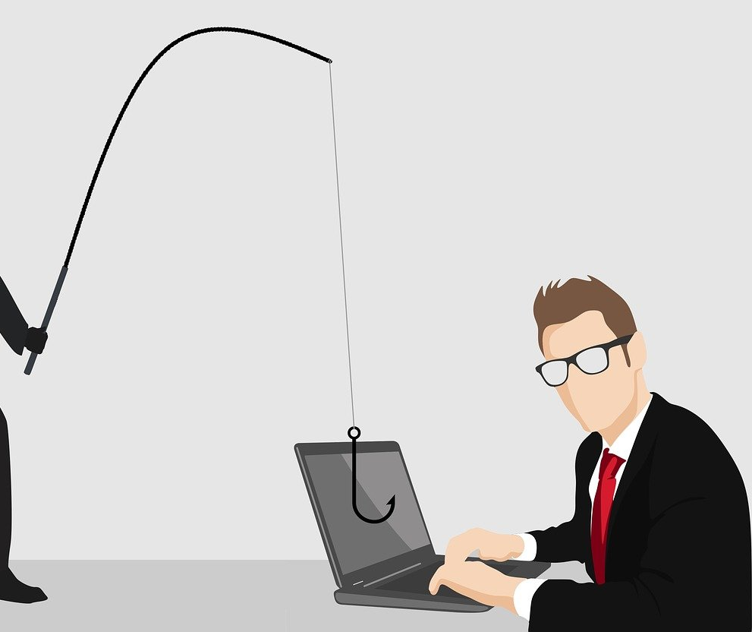
Recognizing Social Engineering Attacks
Watering holes
is a targeted cyber threat where attackers compromise a trusted, legitimate website frequented by a specific target group. They lie in wait for the users to visit the compromised site, at which point malware is automatically downloaded to the user's device to gain access to their network.
Phishing Scams
Phishing involves deceptive emails or websites designed to trick users into sharing confidential information, such as passwords or financial data.
Pre-texting Tactics
Pre-texting occurs when an attacker fabricates a believable scenario to obtain sensitive information from individuals.
Notes:
Image source: Microsoft 365 content library Social engineering attacks manipulate individuals into divulging confidential information. Phishing uses deceptive emails or websites to trick users. Pre-texting involves an attacker fabricating a scenario to obtain sensitive data. Tailgating occurs when someone follows authorized personnel into restricted areas to gain physical access. Awareness and vigilance are key to prevention.

Slide 11

Notes:
Source: https://www.youtube.com/watch?v=-NEnDpcHkhY

Slide 12
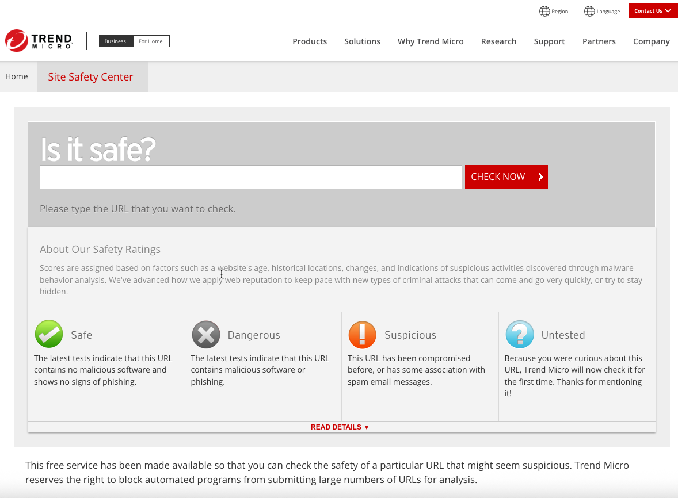

Slide 13

Phishing scams
A phishing attack deceives users into clicking harmful links that lead to fake sites, aiming to steal personal information like bank details or passwords through emails, messages, or other communications.

Slide 14
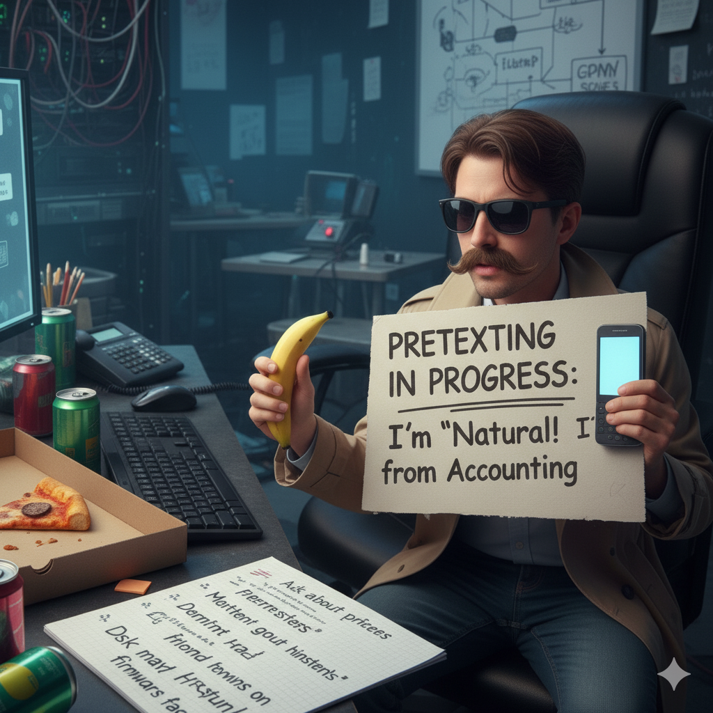
Pre-texting
Threat actors might impersonate coworkers, bank staff, or tech support to earn your trust. Always confirm their identity through reliable channels before sharing sensitive information or following unusual requests.

Slide 15

Social Engineering Principles
Familiarity and likability help social engineers appear friendly and make their requests seem reasonable, reducing suspicion even if denied and allowing them to target others unnoticed.

Slide 16
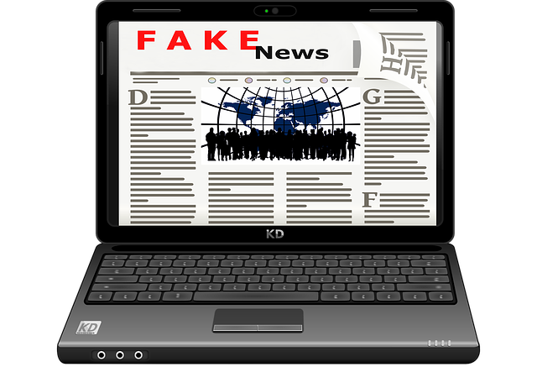
Social Engineering Principles
Consensus, or social proof means people often follow what they believe others would do without direct instructions. For instance, an attacker might trick users into trusting a fake website by posting many false positive reviews.

Slide 17
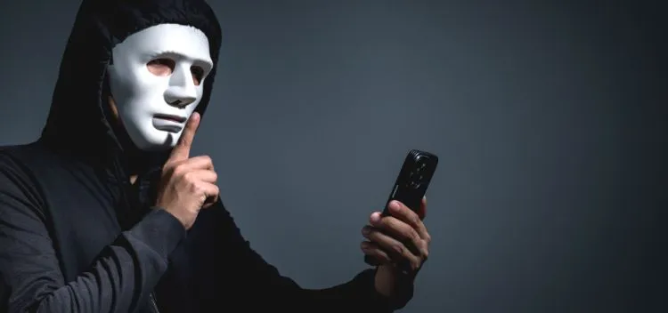
Social Engineering Principles
Authority and Intimidation
Social engineers may exploit this by impersonating high-ranking figures like executives, police officers, judges, or doctors to intimidate their targets.

Slide 18

Social Engineering Principles
Scarcity and Urgency
The social engineer can try to pressure his or her target by demanding a quick response. For example, the social engineer might try to get the target to sign up for a "limited time" or "invitation-only" trial and request a username and password for the service (hoping that the target will offer a password he or she has used for other accounts).
Notes:
Social Engineers exploit the sense of urgency of workers.

Slide 19
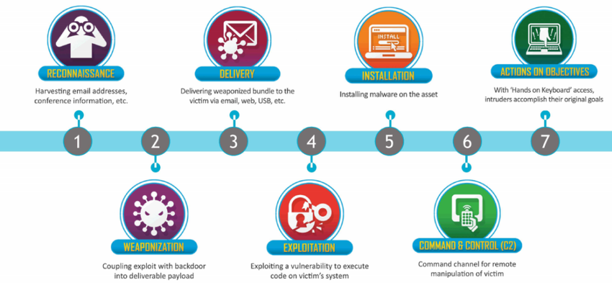
Cyber Kill Chain

Slide 20
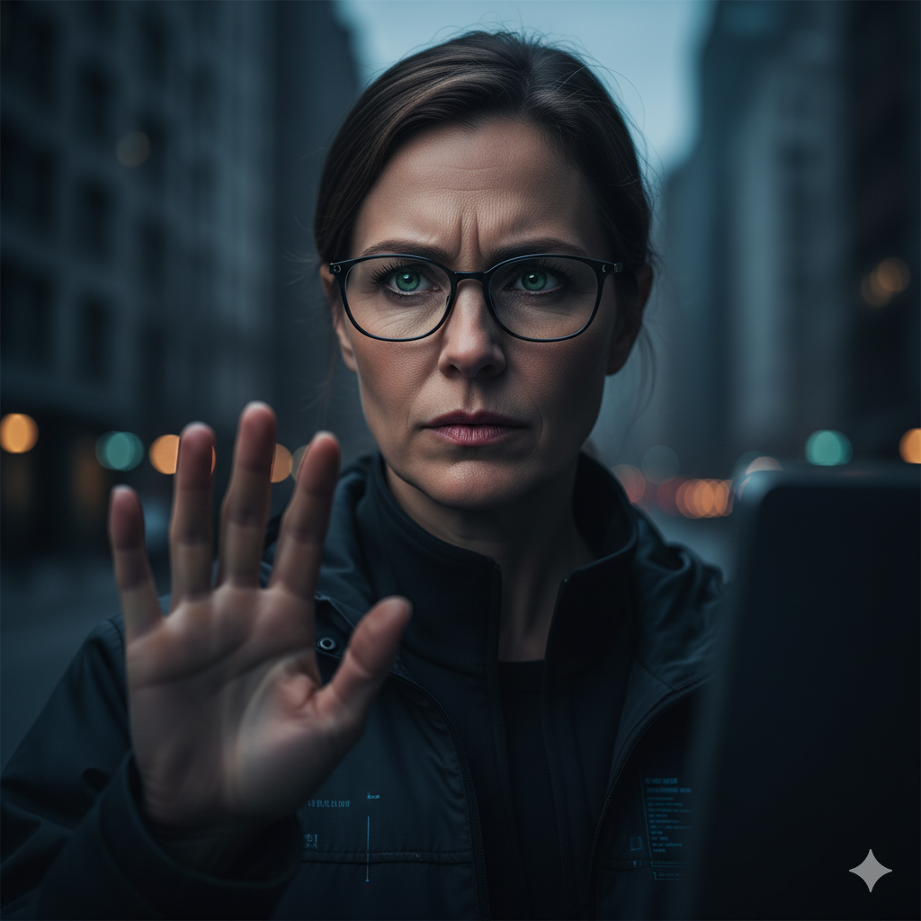
Vigilance and Healthy Skepticism
Question unusual requests—pause before acting
Trust but verify identities through secure channels
Pay attention to small details—”the devil is in the details”

Slide 21
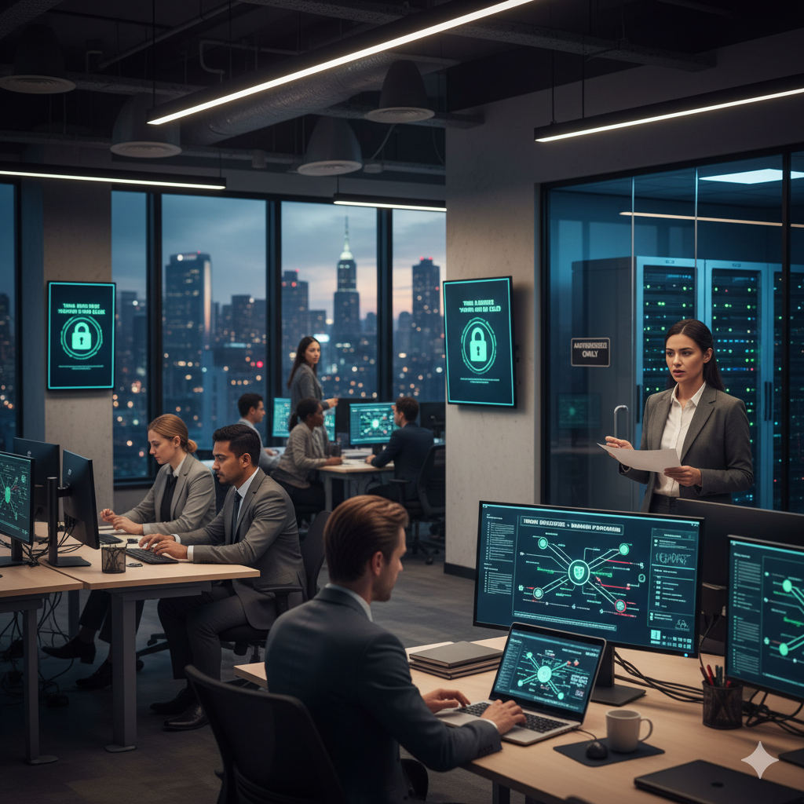
Building a Security-Conscious Culture
Compliance is not enough—culture matters
Encourage reporting: employees should feel safe speaking up
Establish a swift alert protocol for rapid response
Promote ongoing, engaging, and tailored learning

Slide 22

Spot and Report Incidents
Promptly Report Issues
Report any suspicious incidents immediately using your organization’s established procedures to ensure a swift response.
Recognize Security Incidents
Identify unusual activity, unauthorized access, or suspicious emails that could indicate a security threat.
Minimize Potential Damage
Quick reporting enables an effective response, reducing the risk and minimizing potential harm to organizational assets.
Notes:
Image source: Microsoft 365 content library Recognizing potential security incidents is vital to protecting organizational assets. Look for unusual activity, unauthorized access, or suspicious emails. If you notice something suspicious, promptly report it following your organization’s established procedures to enable a rapid and effective response, helping to minimize potential damage.

Slide 24
Questions?

Slide 25
References
Cyber Kill chain. (n.d.). Lockheed Martin. https://www.lockheedmartin.com/en-us/capabilities/cyber/cyber-kill-chain.html
Marlow, O., & Marlow, O. (2025, May 13). What Is a Human Firewall? Turn Employees into Defenders. HBS -. https://www.hbs.net/blog/what-is-a-human-firewall
Social engineering principles. (n.d.). https://library.mosse-institute.com/articles/2023/07/social-engineering-principles.html
What is a human firewall? Meaning | ProofPoint US. (2025, June 2). Proofpoint. https://www.proofpoint.com/us/threat-reference/human-firewall

Slide 26
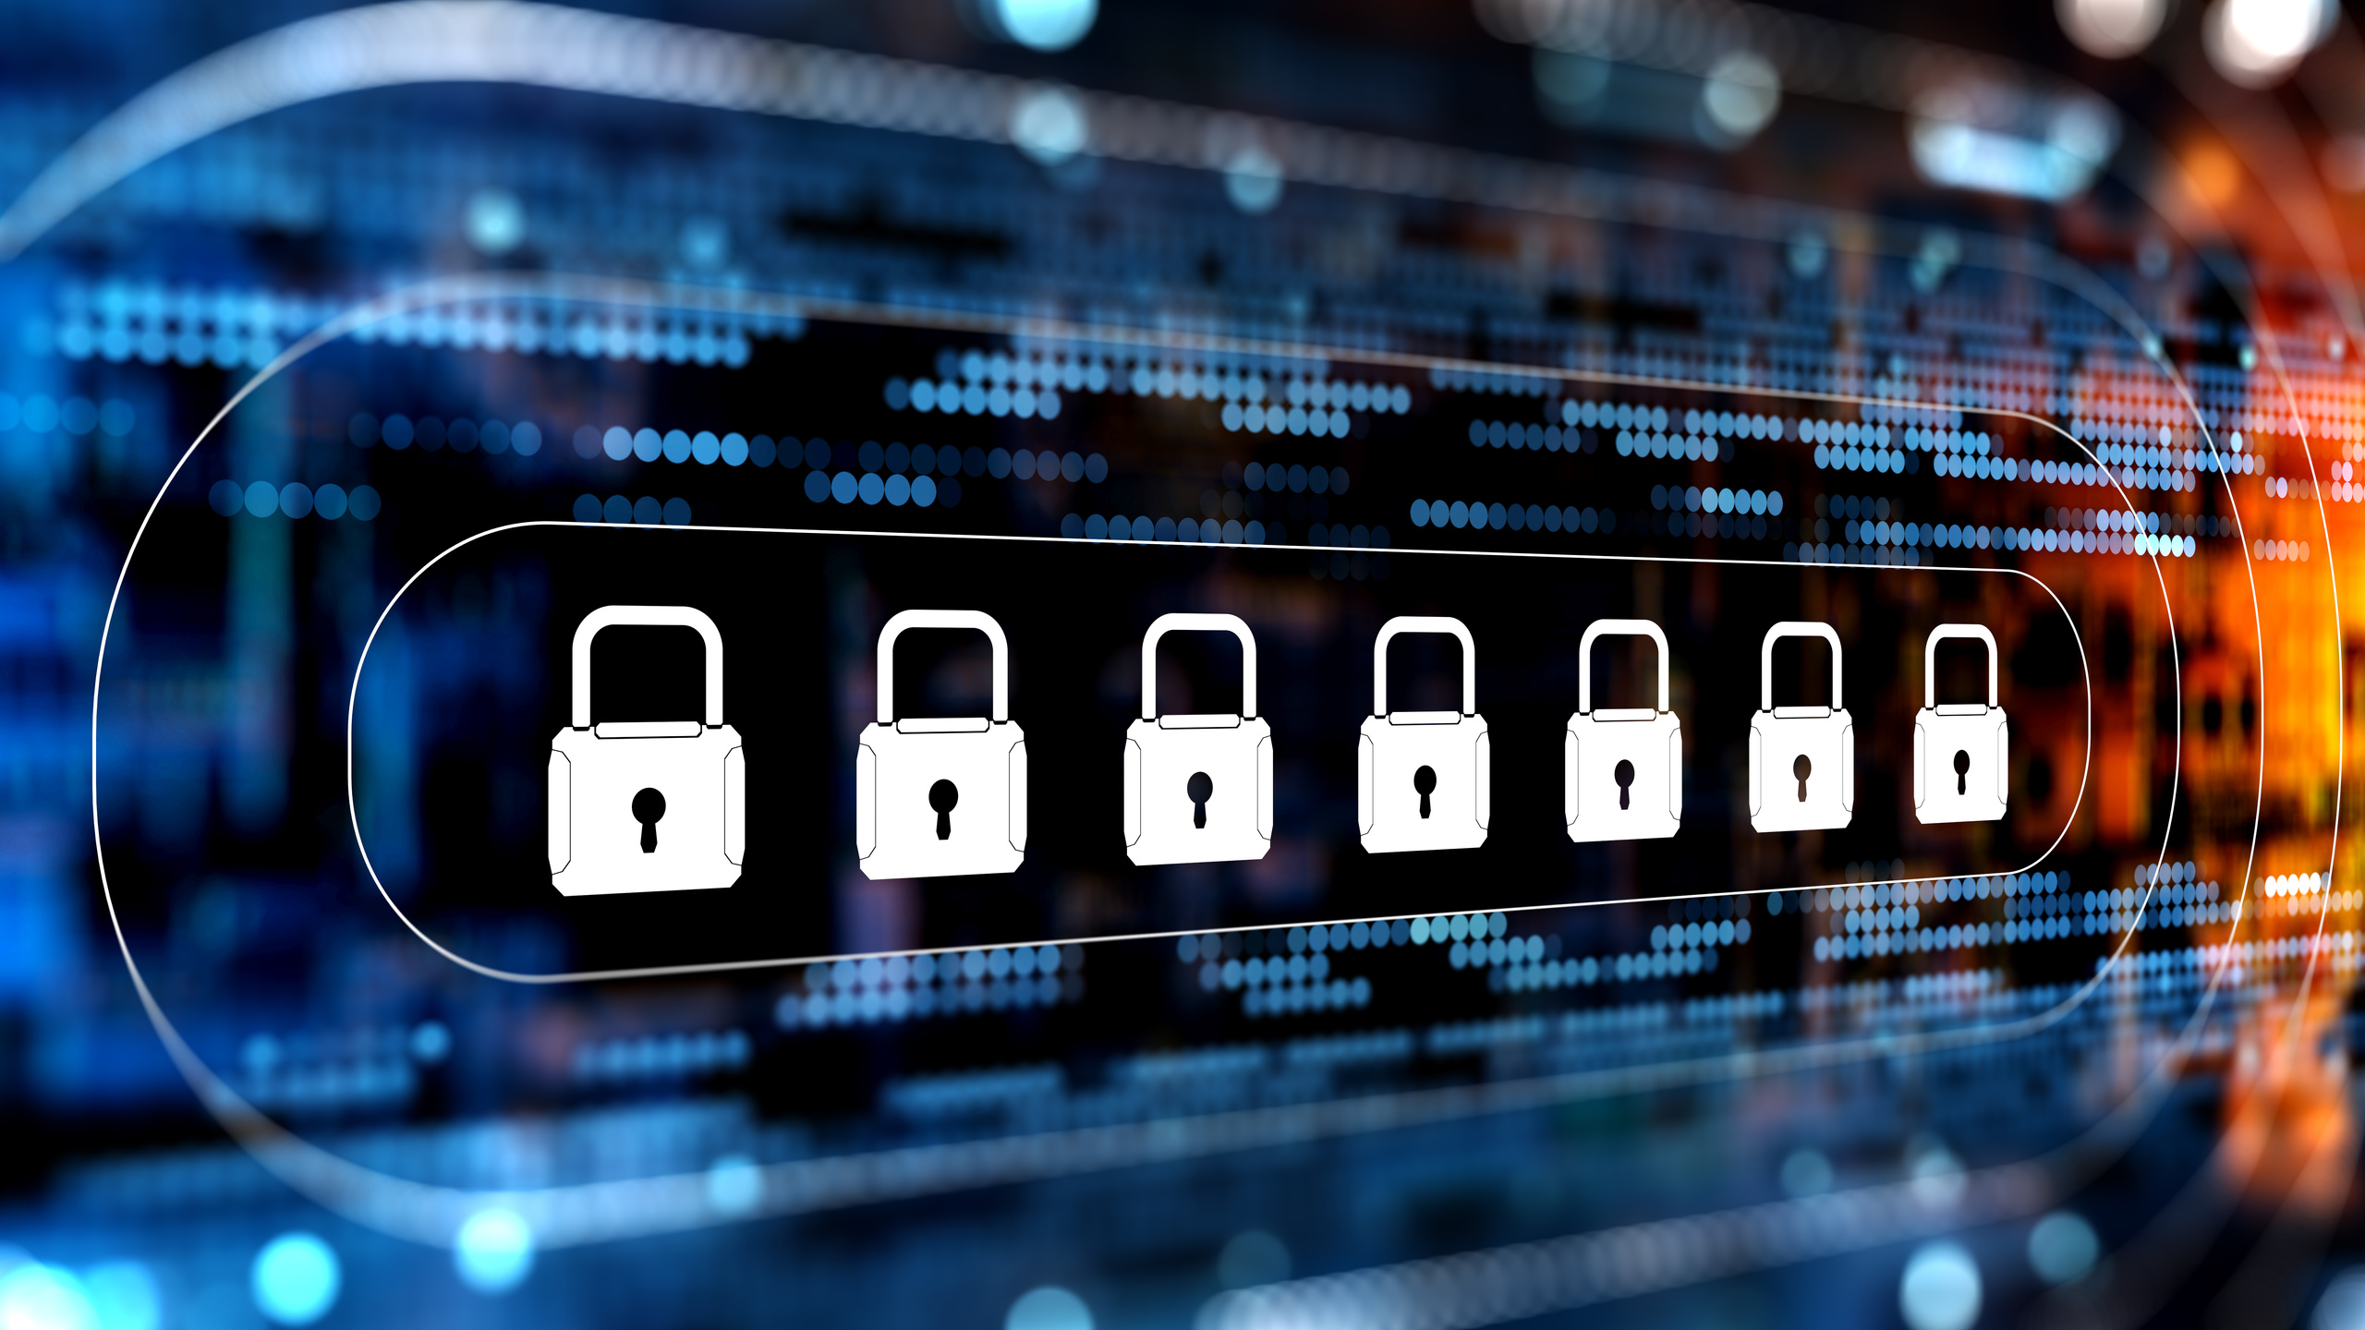
SESSION 2:
CYBERSECURITY
PRESENTER:
KINA BABAUTA
OFFICE OF INFORMATION TECHNOLOGY (OIT)

Slide 27
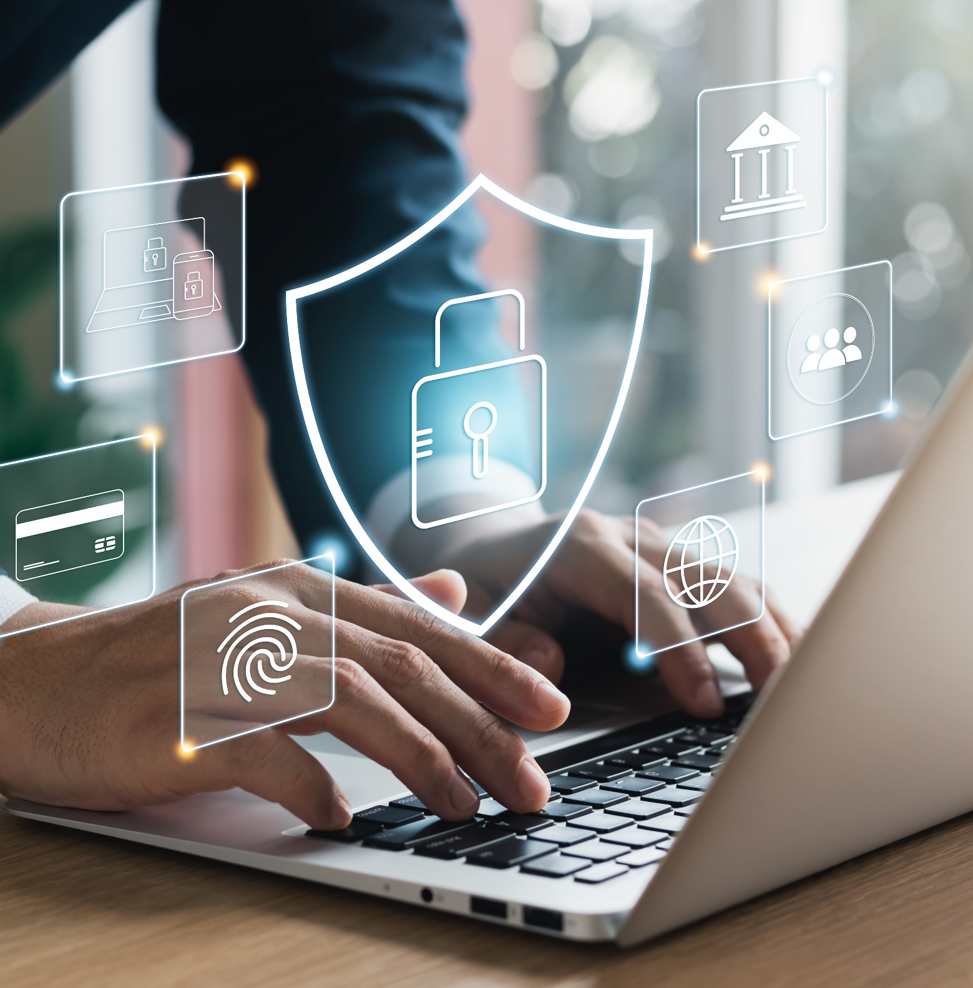
What Is Cybersecurity?
Cybersecurity is the protection of computer systems and networks from attacks by malicious actors that could cause unauthorized information disclosure, theft, or damage to hardware, software or data.​
Wherever there is technology, there needs to be cybersecurity.

Slide 28

Why Is it Important?
Implementing cybersecurity best practices helps protect intellectual property and other sensitive data, as well as networks and systems that support your operations.
For both government and private entities, developing and implementing tailored cybersecurity plans and processes is key to safeguarding operations and protecting critical infrastructure.
Notes:
Technology is everywhere:
From government systems and workplace networks to smartphones and smart homes, technology drives everything we do.
The more connected we become, the more opportunities cybercriminals have to exploit weaknesses.
Every innovation brings great benefits and new risks.
Cybersecurity protects what technology creates.
Every device is a door: Your computer, phone, and network connections are potential entry points for attackers.
Cybersecurity acts as a lock, the alarm, and the guard preventing intruders from gaining access.
Remember: The more devices we use, the more doors we have to secure.
It’s not just about technology, it’s about TRUST: Cybersecurity protects the trust people place in our government and the services we provide them. Without cybersecurity, that trust disappears. Rebuilding it is harder than preventing it.
Cybersecurity is a shared responsibility: IT can build firewalls and deploys tools, but security depends on everyone’s actions.
REMEMBER: Technology can’t protect itself; it needs people who care about security.
WHERE THERE IS TECHNOLOGY, THERE MUST BE CYBERSECURITY, BECAUSE PROGRESS WITHOUT PROTECTION IS RISK.

Slide 29
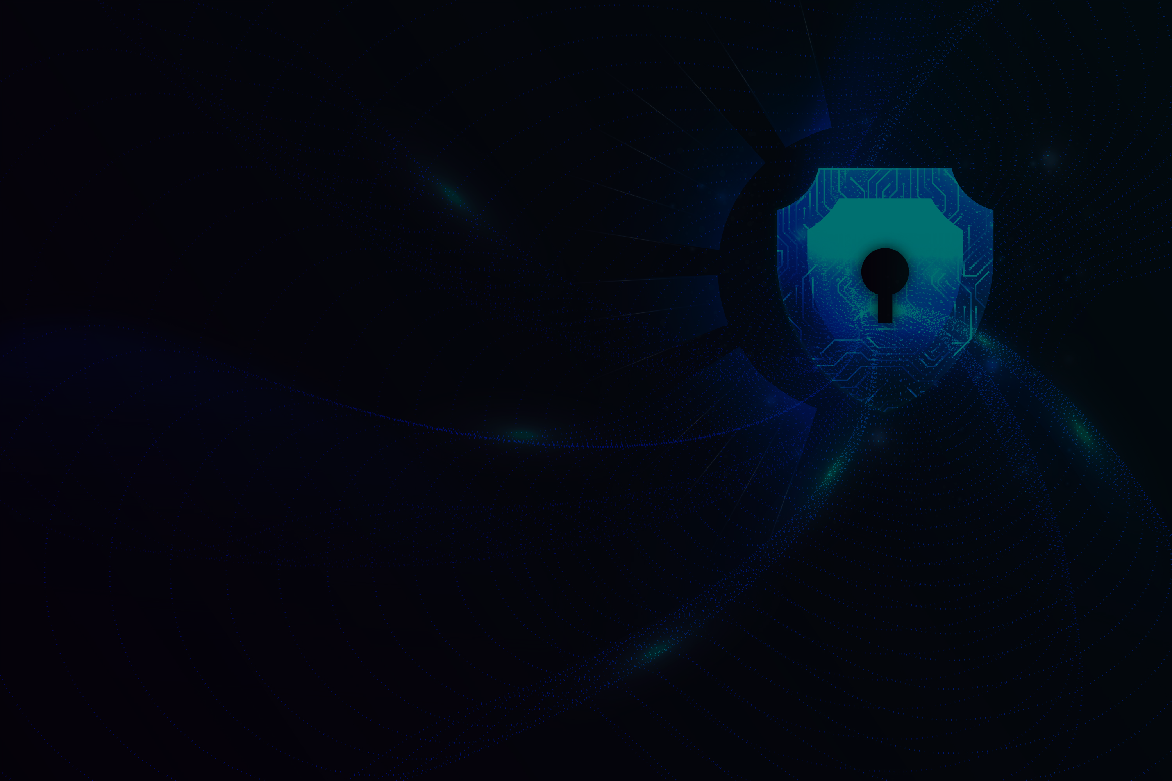
Four Essential Behaviors to Stay Safe Online
Update software​​
Use strong passwords and a password manager ​​
Turn on multifactor authentication (MFA) ​​
Recognize and report phishing

Slide 30
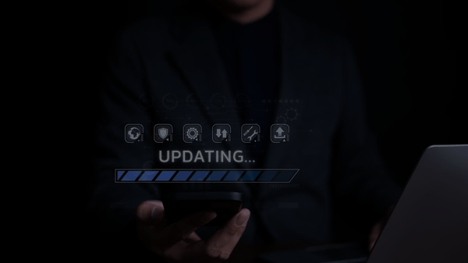
Update Software
What should you remember about updates?
Updates often improve performance, efficiency and address security issues, so it's important to keep your devices up-to-date. Enable automatic updates for convenience.

Slide 31
Update Software
Key reasons for updating software:
Enhanced Security:
Updates often contain patches for security vulnerabilities that attackers could use to compromise your devices, steal data, or install malware.
Improved Performance:
Updates can optimize your system, making it run faster, more efficiently, and with fewer bugs or crashes.
Bug Fixes:
Updates resolve existing bugs and errors in the software, which can cause system instability or unexpected behavior.
Notes:
Keeping software up-to-date isn’t just about getting new features, it’s about staying protected and productive.
Attackers are always looking for weaknesses in programs like small flaws in the code that they can use to gain access or disrupt systems. Software updates are release to help address these weaknesses and when we push off installing the updates, we are essentially leaving the door wide open for those with malicious intent to come on in.
Software doesn’t just cover our computer operating system, its also things like our browsers, computer, and cell phone apps.
When you see the update notification, don’t delay, click “Update and Shut Down” at the end of the day. It’s one of the simplest ways to protect your data and keep your devices running their best.

Slide 32
Update Software
What happens if you don't update:
Increased Risk of Cyberattacks:
Outdated software with known security flaws is a prime target for hackers.
Data Loss and Financial Damage:
Successful attacks on vulnerable systems can lead to data breaches, loss, or corruption of files.
System Instability:
Without updates, your software may become unstable, leading to frequent crashes and poor performance.
Notes:
When we skip software updates, we leave our systems open to security threats.
Ignoring updates might save a few minutes today, but it can cost hours or even data tomorrow.
STAY UPDATED, STAY PROTECTED.

Slide 33

Update Software
Where do you find available updates?
Windows:
Click the Start button and go to Settings.
Select Update & Security.
Choose Windows Update and click Check for updates to find and install any available updates.
macOS:
Open System Settings (or System Preferences).
Click on Software Update.
Select Update Now to download and install the updates.
Android:
Open the Settings app.
Navigate to System (or About phone).
Tap on Software update or System update to find and install the latest version.
iOS (iPhone):
Open the Settings app.
Select General, then tap Software Update.
Choose to Download and Install the update.
You may need to restart your device after installing an update to complete the process.

Slide 34
Update Software (Browsers)
Where do you find available updates?
Google Chrome:
Open Chrome and click the More menu (three dots) in the top right.
Select Help from the dropdown menu.
Click About Google Chrome.
Chrome will check for updates; if one is available, select Relaunch to complete the process.
Safari:
For Macs, update Safari by updating your macOS.
For iPhones and iPads, update Safari by updating your iOS or iPadOS operating system.
Microsoft Edge:
Open Edge on your computer.
Click on the Settings and more icon (three dots).
Go to Settings.
Navigate to the Privacy, search, and services or Site permissions section to manage site-specific permissions.
You may need to restart your device after installing an update to complete the process.

Slide 35
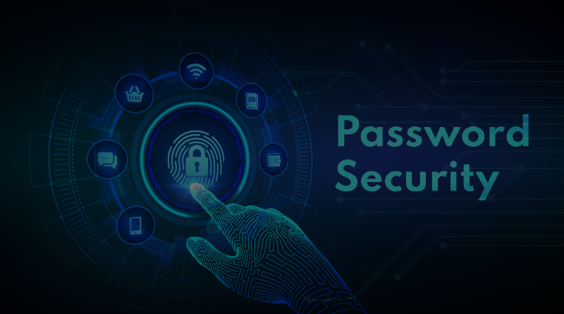
Use Strong Passwords
What makes a strong password?
Random​
Upper- and lower-case letters​
Numbers​
Special characters (!@#$_-)
Spaces​
Consider passphrases​ (5-7 unrelated words. Boat-Volcano-Unicorn-Shelf-Coconut-626!).
Unique
Different for each account
NEVER reuse passwords​.
Long ​
At least 16 characters​
Encryption ensures that password managers never "know" what your passwords are, keeping them safe from cyberattacks.
Notes:
Strong passwords are your first line of defense online. A weak password is like leaving your front door unlocked, it’s an open invitation for hackers.
Passphrases – Don’t use words that you usually use or that’s familiar to YOU – “I can’t repeat my usual words here” but if I did, my colleagues would have no trouble guessing them.
REMEMBER: A STRONG PASSWORD PROTECTS YOUR IDENTITY, YOUR DATA, AND YOUR DIGITAL LIFE.

Slide 36
Use Strong Passwords
Why use a password manager?
Stores your passwords.
Alerts you of duplicate passwords​.
Generates strong passwords​.
Fills in your login credentials on websites to make sign-in easy.​
Won't fall for a phishing website, even if you do.
Encryption ensures that password managers never "know" what your passwords are, keeping them safe from cyberattacks.
Notes:
Remembering dozens of strong, unique passwords can be tough, that’s where a password manager comes in.
Password managers can be synced across your devices. You will always have access to your passwords (i.e: phone, laptop, computer)
Paid has no limitations, free does.
Think of it as having a secure digital keychain, using password manager significantly reduces your risk of cyberattacks while making your online much easier.

Slide 37
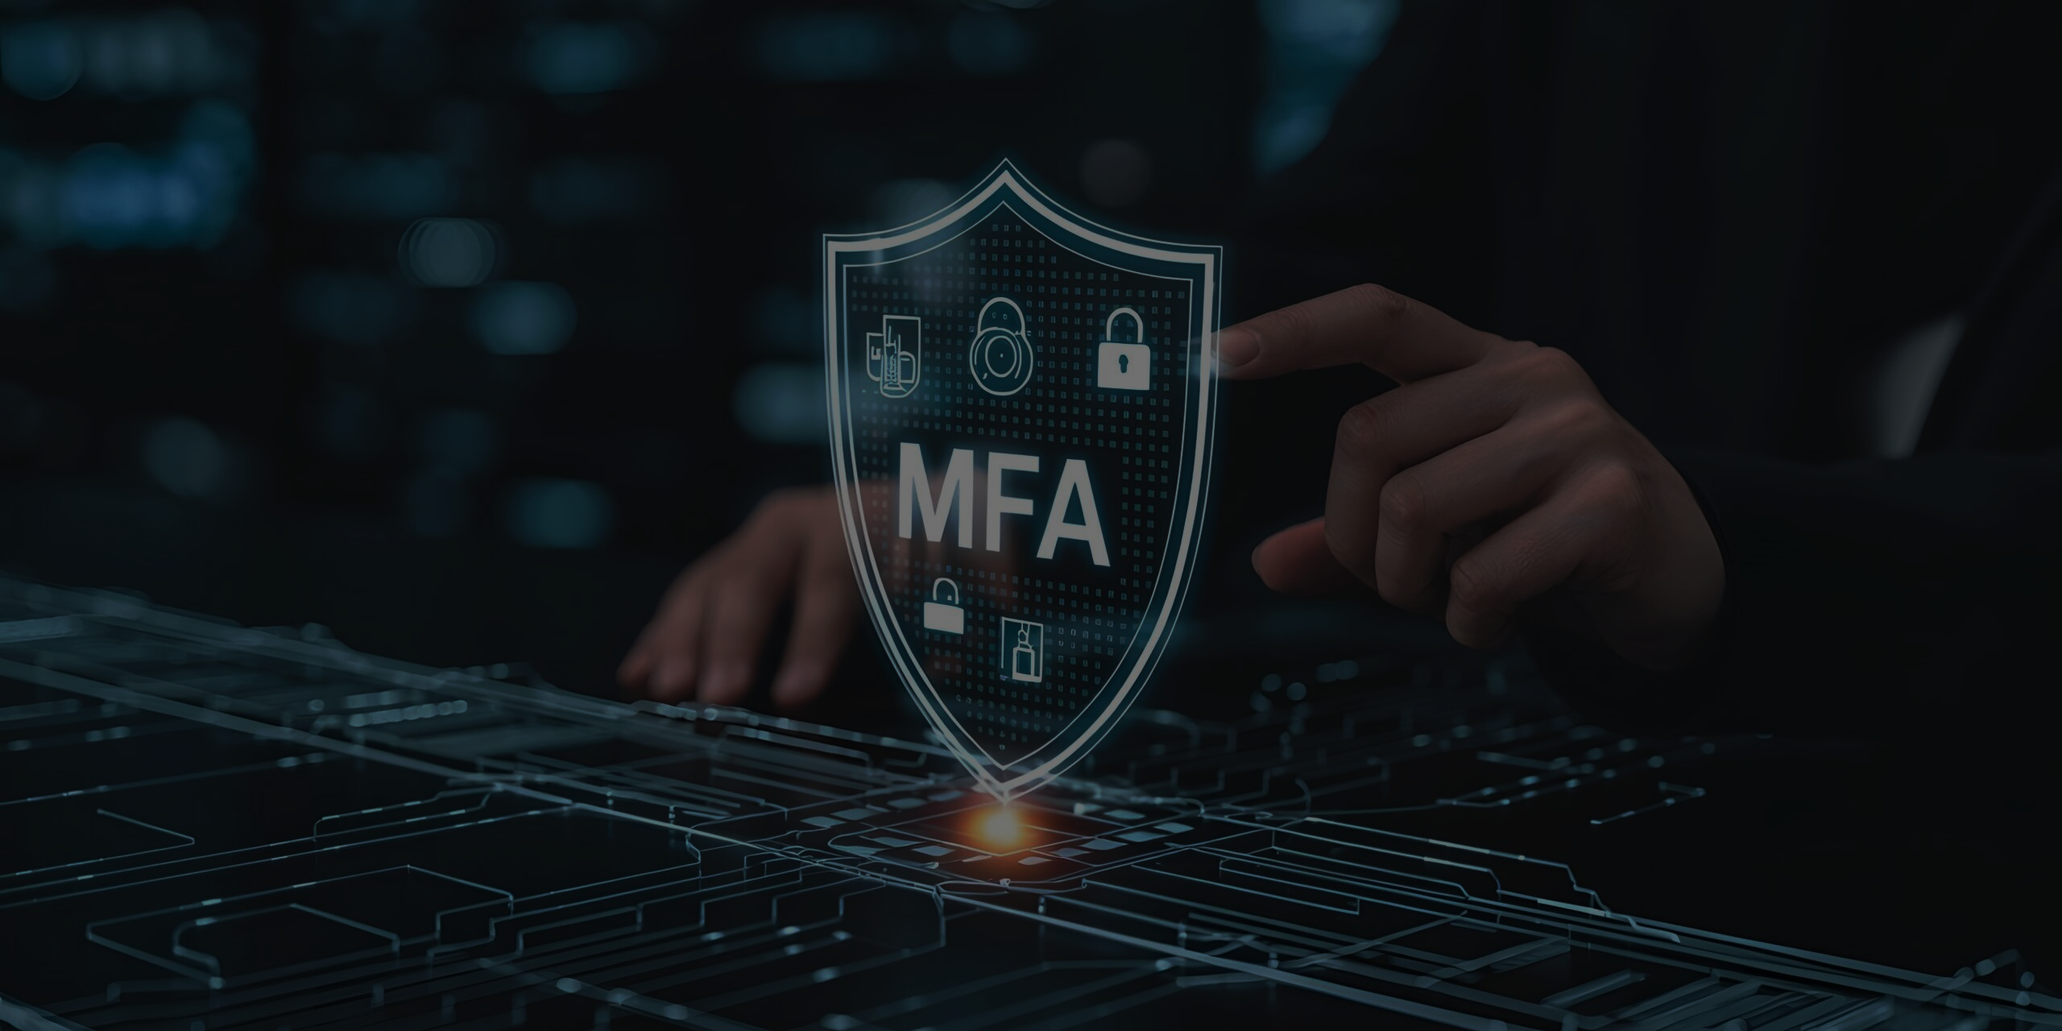
Turn on Multifactor Authentication
What is MFA and where should you use it?
Multifactor authentication (MFA) provides an extra layer of security for your accounts by requiring a quick second step to verify your identity when logging in.
Use it on every account that offers it, especially:
Email​
Accounts with financial information​
Accounts with personal information​
Notes:
Passwords alone aren’t enough to keep accounts safe. MFA adds an extra layer of protection by requiring a second form of verification, like a code sent to your phone or an authentication.
Even if a hacker steals your password, they can’t access your account without a second authentication. MFA makes it much harder for attackers to break in, protecting your data, accounts and personal information.
MFA is – Something you know (password) Something you are (biometric) Something you have (phone or email)
THINK OF IT LIKE A DOUBLE LOCK ON OUR FRONT DOOR, ONE LOCK ISN’T ENOUGH, TWO KEEPS YOU SECURE.

Slide 38
Turn on Multifactor Authentication
Which MFA methods are best?
Choose the most secure MFA method available or a combination of the following. Here are some options, from most to least secure:
Security key: Use a physical security key (such as a YubiKey) to log in. It plugs in or taps your device. It provides the best protection against phishing and is easy to use.
Authenticator app with number matching: An app prompts you to enter a number on your phone. You enter a number shown on the login screen to confirm your identity.
Authenticator app with one-time code: An app generates a new code every 30 seconds.
Biometrics: Uses your fingerprint or face to confirm your identity.
Text or email code: A one-time code is sent to your phone or email. Least secure method.
Notes:
A YubiKey is a physical hardware security key used for MFA to secure accounts and devices against unauthorized access including phishing attacks

Slide 39
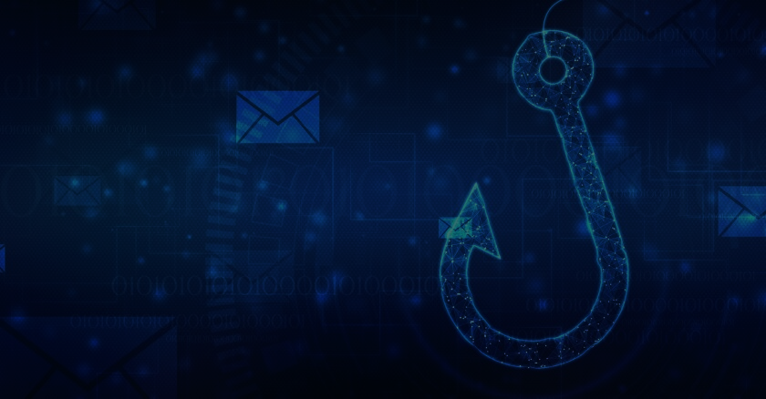
What is Phishing?
Phishing is a social-engineering attack where an adversary attempts to trick people into revealing sensitive information or performing actions that compromise security (clicking malicious links, opening infected attachments, transferring funds, or revealing credentials). Phishing can target individuals (spear-phishing), groups, or entire organizations.

Slide 40
What is Phishing?
How can you tell if a message is phishing?
A tone that’s urgent or makes you scared​ ​
Ex: "Click this link immediately or your account
will be closed."​​
Sender email address doesn’t match the company it’s coming from ​
Ex: Amazon.com vs. Amaz0n.com ​
Unexpected communications such as an email or attachment you weren't expecting​
Requests to send personal info​
Legitimate organizations don't ask for personal
information through email or an unexpected call.
Misspelled words, bad grammar​ and odd URLs​
Be aware that AI will make spotting these more
challenging— stay diligent.

Slide 41
Common Types of Phishing
Email phishing: mass or targeted emails that mimic trusted senders.
Spear-phishing: highly targeted emails tailored to a specific person or role.
Whaling: phishing aimed at senior execs/finance for high-value fraud.
Smishing: phishing via SMS/text messages.
Vishing: phishing via voice calls (phone).
Clone phishing: a legitimate email is copied, attachments/links swapped for malicious ones, and resent.
Business Email Compromise (BEC): attackers spoof or compromise business accounts to request wire transfers or sensitive actions.
Credential harvesting sites: fake login pages to capture usernames/passwords.
Malicious attachments: Office documents/macros, PDFs, or compressed files that install malware or ransomware.

Slide 42
Recognize and Report Phishing
What should you do if you spot a phish?
DO
DON'T
Verify that the communication is real and contact the sender directly through known phone numbers or emails.
Report it to your IT department or email/phone provider.
Use email filters​. Many email services have filters that can help prevent phishing messages from ever reaching your employees’ mailboxes.
DELETE IT.
Don't click any links you don’t trust, even “unsubscribe” (just delete).
Don't click any attachments you were not expecting or recognize.
Don't send personal info online or share over the phone.

Slide 43
Conclusion: Cybersecurity
Cybersecurity isn’t just an IT responsibility, it’s everyone’s responsibility.
Every click, every email, and every password we use plays a role in protecting not only our organization but also our personal lives.
At work, cyber-aware keeps our government services running, protects sensitive data, and preserves the public’s trust.
At home, it safeguards our families, finances, and personal information from those who seek to exploit it.
When we stay informed, think before you click, and take security seriously, we build a stronger and safer digital community together. Remember Cybersecurity starts with you.
Please Stay Safe Online.

Slide 44
SESSION 3:
PHYSICAL SECURITY
PRESENTER:
JOSEPH S. SANTOS
OFFICE OF INFORMATION TECHNOLOGY

Slide 45
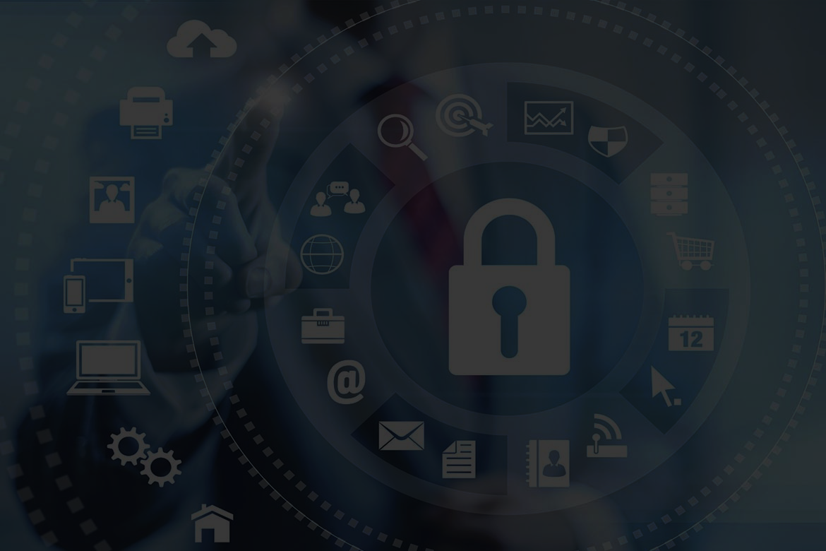
What is Physical Security?
Physical Security is the protection of people, property, information, and assets from physical threats like theft, vandalism, natural disasters, and unauthorized access.
The 5 D’s of Physical Security
Deter: Discourage potential intruders before they even attempt to act.
Detect: Identify threats as early as possible.
Deny: Prevent unauthorized access to a facility or asset.
Delay: Slow down an intruder to buy critical time for a proper response.
Defend: Actively respond to a threat once it has bypassed the other layers.

Slide 46
Deter
Uses visual security measures to deter an intruder’s attempts to breach your facility.
Fencing and gates: Form a clear boundary and can be equipped with additional security features like barbed wire or electric fencing for high-security areas.
Lighting: Bright and well-placed lighting can minimize vulnerable areas for intruders to hide and often deters a breach before it happens.
Security personnel and patrols: Human security guards and regular patrols remain a crucial element of physical security. Security guards provide a visible deterrent, can respond quickly to incidents, and can make judgment calls in complex situations.

Slide 47
Detect
Monitors the perimeter using cameras and motion sensors to identify threats as early as possible.
CCTV Surveillance Cameras: CCTV security cameras provide continuous monitoring of the property's boundaries, allowing security personnel to quickly detect and respond to potential threats and potential attacks. Video feeds aid security teams and law enforcement with valuable insights.
IP POE Cameras: Like CCTV cameras, IP POE cameras will continuously monitor your property, but these video feeds can be accessed remotely and, provided your Network Video Recorder (NVR) is setup correctly with an Uninterrupted Power Supply (UPS), will continue to monitor and record during a power outage.
Panoramic and Pan-Tilt-Zoom (PTZ) Cameras: Offers wide coverage and the ability to zoom in on specific activity.
Motion Detectors: Detects motion in a specific area with automated lighting, sending a notification to your security team.
Thermal Sensors: Monitors changes in heat levels to detect an intruder and alert your security team.

Slide 48
Deny
Prevent unauthorized access to a facility or asset.
Biometric authentication: Biometric systems use unique physical characteristics like fingerprints, facial features, or iris patterns to verify identity. Physical security devices like biometric readers provide a high level of security and eliminate risks associated with lost or stolen access cards.
Key cards and RFID: Radio-frequency identification (RFID) cards and key cards are widely used for access control. They can be easily issued, revoked, and tracked, providing flexible and manageable access control.
High security fences: Height for these fences can vary; but are typically 8 to 12 feet tall and may include additional features like barbed wire or anti-climb toppings.

Slide 49
Delay
Slow down an intruder to buy critical time for a proper response.
Bollards: Concrete or steel pipes to prevent vehicle access slowing down potential ramming attacks
Steel doors with magnetic locks: Keep doors closed using the force of an electromagnetic field rather than a physical latch or lock. Has no protruding elements for intruders to perform lock picking.
Multiple layers of fencing: Forces intruder to climb more than one fence, slowing down their progress into the facilities and buying time for security personnel to respond.

Slide 50
Defend
Actively respond to a threat once it has bypassed the other layers.
Security Personnel: Patrols the area, ready to respond to any suspicious activity.
Integrated Alarm System: Sensors and cameras connected to an alarm system that alerts personnel or remote monitoring services when triggered.
Employee Training: Educate staff on how to respond to emergencies and recognize suspicious activities.

Slide 51
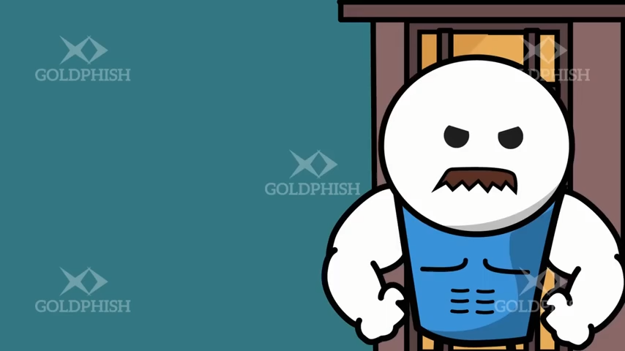

Slide 52
Conclusion
Physical security remains a critical component of overall organizational security. By implementing a comprehensive physical security strategy that includes perimeter defense, access control, surveillance, and intrusion detection, organizations can significantly reduce their vulnerability to physical threats. These layers of security are essential for physical security management.
As technology continues to advance, the field of physical security will evolve, offering new tools and methods to protect assets and people. However, the fundamental principles of physical security—deterrence, detection, delay, and response—will remain constant in your physical security strategy.
Organizations must stay informed about emerging threats and technologies, regularly assess their security posture, and adapt their physical security measures accordingly. By doing so, they can ensure the safety of their personnel, protect their assets, and maintain the integrity of their operations in an increasingly complex security landscape.

Slide 53
SESSION 4:
JITBIT HELPDESK PORTAL
PRESENTER:
JOSTAN INOKE
OFFICE OF INFORMATION TECHNOLOGY

Slide 54
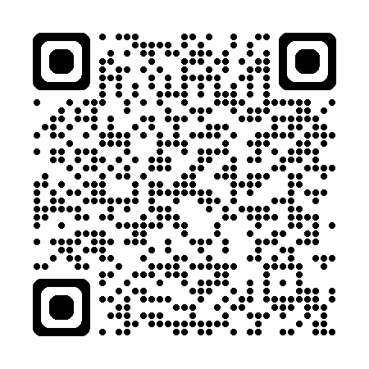
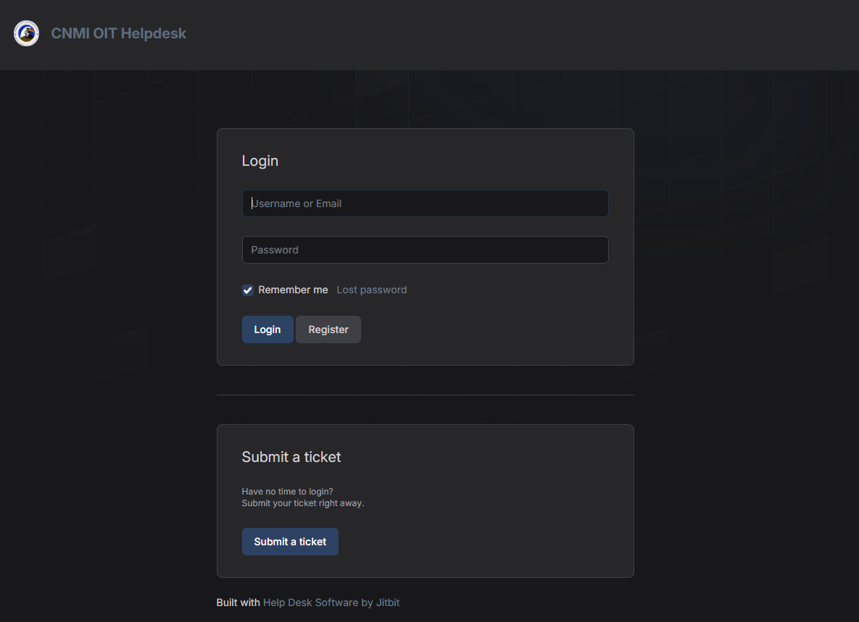
How do you report a cyber incident, or suspected cyber incident to OIT?
Access the Helpdesk
Go to our Helpdesk portal: https://helpdesk.oit.cnmi.gov
Submit a Ticket
Users have two options to submit a ticket: 1) Login and submit a ticket or 2) Use the "Submit a ticket" section to submit one right away without doing so.
Provide Details
Select the category: “⚠️ Report a Cyber/Physical Security Issue”
Describe the incident or suspicious activity
Attach screenshot, if available
Inform OIT if you clicked on a link or opened a file.
Submit
You should receive an email confirming the ticket submission.
1
2

Slide 55
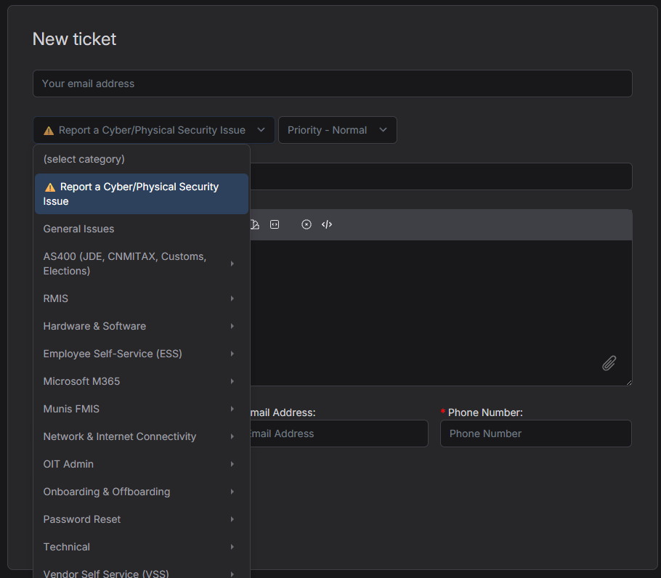
How do you report a cyber incident, or suspected cyber incident to OIT?
Access the Helpdesk
Go to our Helpdesk portal: https://helpdesk.oit.cnmi.gov
Submit a Ticket
Users have two options to submit a ticket: 1) Login and submit a ticket or 2) Use the "Submit a ticket" section to submit one right away without doing so.
Provide Details
Select the category: "⚠️ Report a Cyber/Physical Security Issue“
Describe the incident or suspicious activity
Attach screenshot, if available
Inform OIT if you clicked on a link or opened a file.
Submit
You should receive an email confirming the ticket submission.

Slide 56
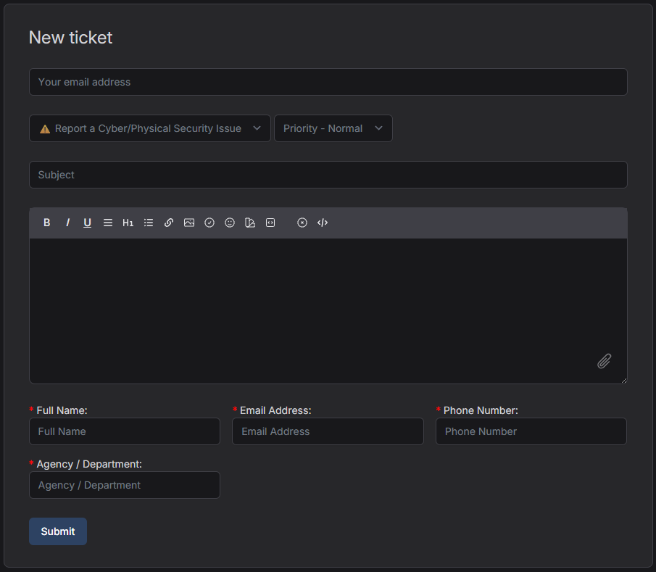
How do you report a cyber incident, or suspected cyber incident to OIT?
Access the Helpdesk
Go to our Helpdesk portal: https://helpdesk.oit.cnmi.gov
Submit a Ticket
Users have two options to submit a ticket: 1) Login and submit a ticket or 2) Use the "Submit a ticket" section to submit one right away without doing so.
Provide Details
Select the category: "⚠️ Report a Cyber/Physical Security Issue“
Describe the incident or suspicious activity
Attach screenshot, if available
Inform OIT if you clicked on a link or opened a file.
Submit
You should receive an email confirming the ticket submission.

Slide 57
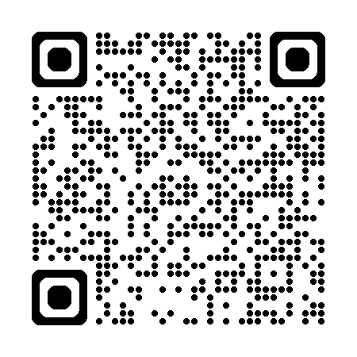
JITBIT Helpdesk Portal
https://helpdesk.oit.cnmi.gov/Tickets/New

Slide 58

SESSION 5:
Pop Quiz
PRESENTER:
FRANK CELIS
OFFICE OF INFORMATION TECHNOLOGY

Slide 59
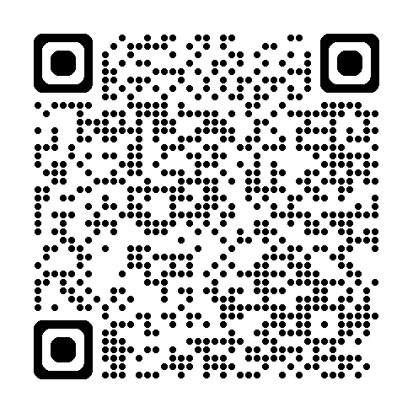
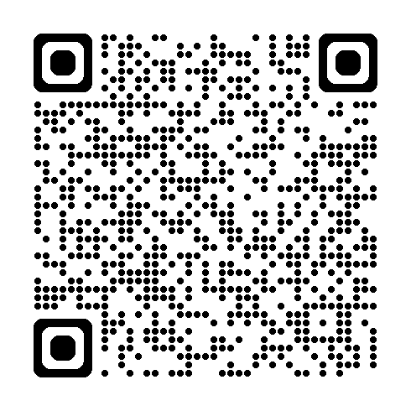
Cyber Security Awareness Flyers
Best Ways to Stay Cyber Safe
Recognize and Report Phishing

Slide 60


QUESTIONS?

Slide 61
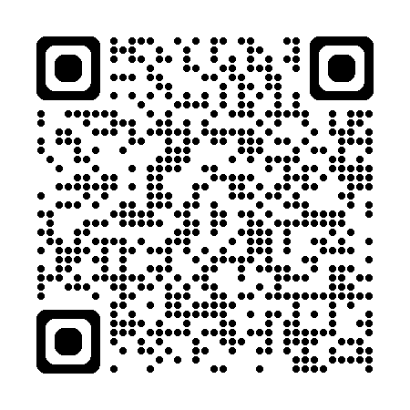
Cyber Security Awareness Month 2025

Slide 62
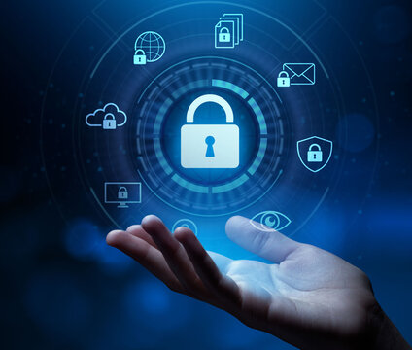



CLOSING
REMARKS
JOAQUINA
“KINA”
BABAUTA
We want to express our gratitude
To our sponsors

Slide 63
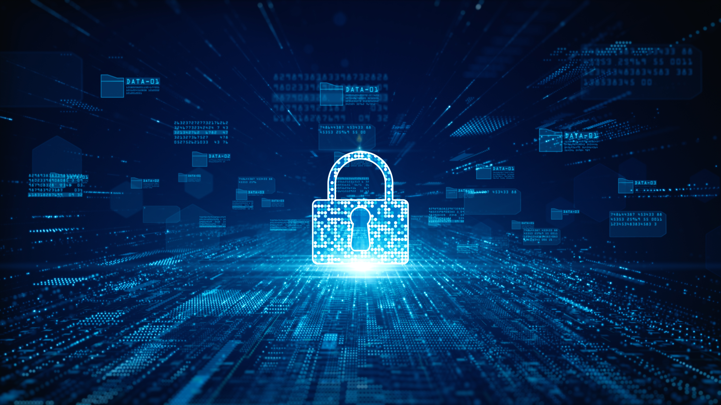
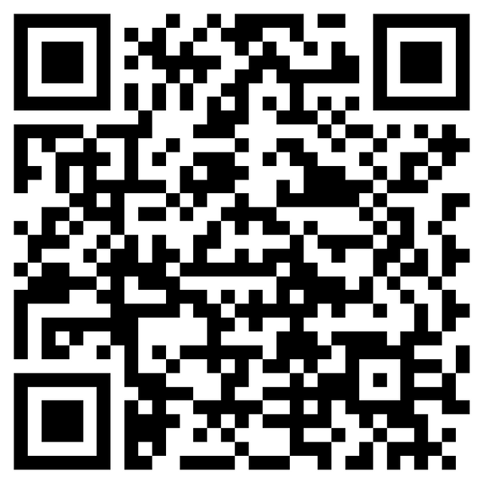
c
THANK YOU FOR COMING
KINDLY FILL OUT THE SURVEY:
https://forms.office.com/g/z2iRiBGsmw

